Slide 1
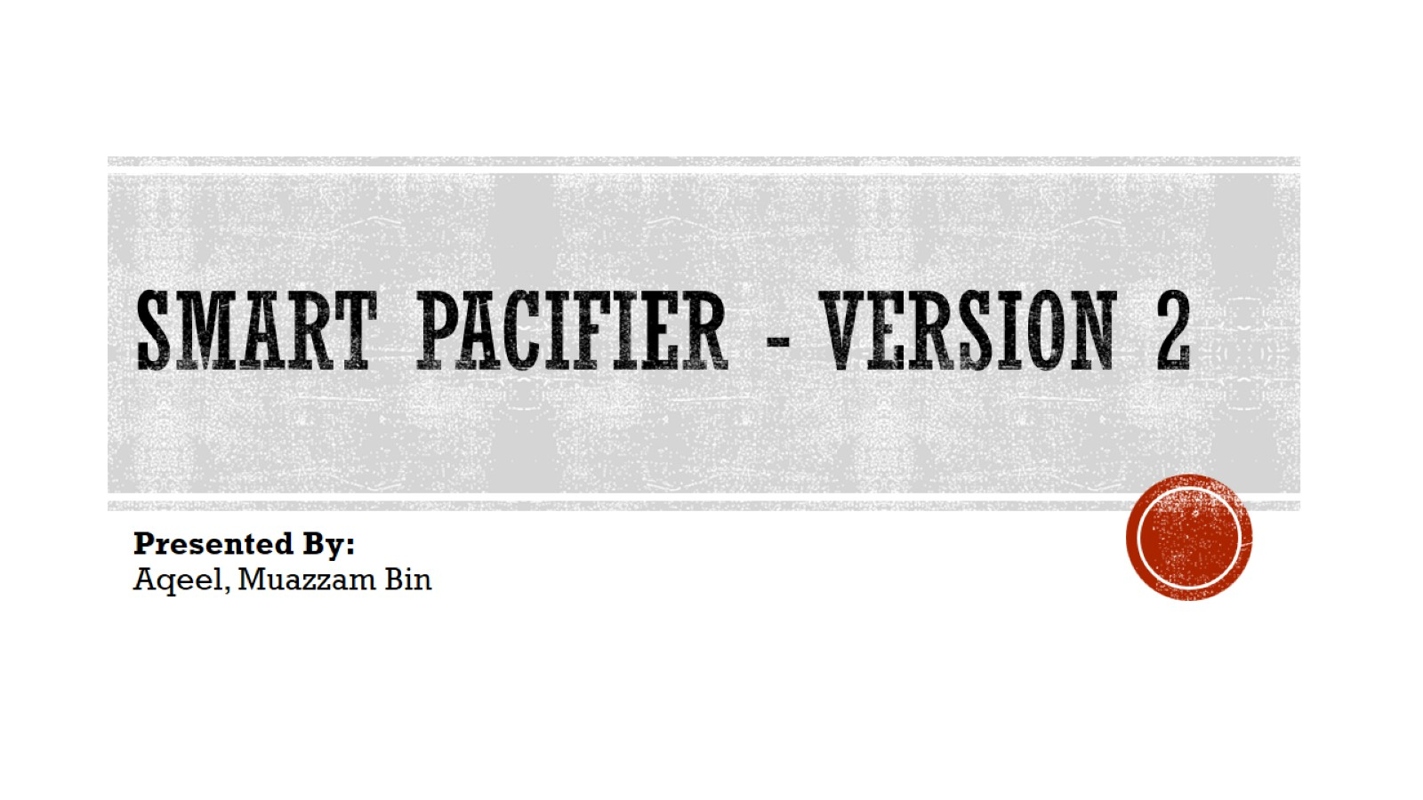
Smart Pacifier - Version 2

Slide 2
Agenda
Front End
Inter Protocol Communication
Back End

Slide 3
Front-End FLUTTER AVALONIA .NET MAUI

Slide 4
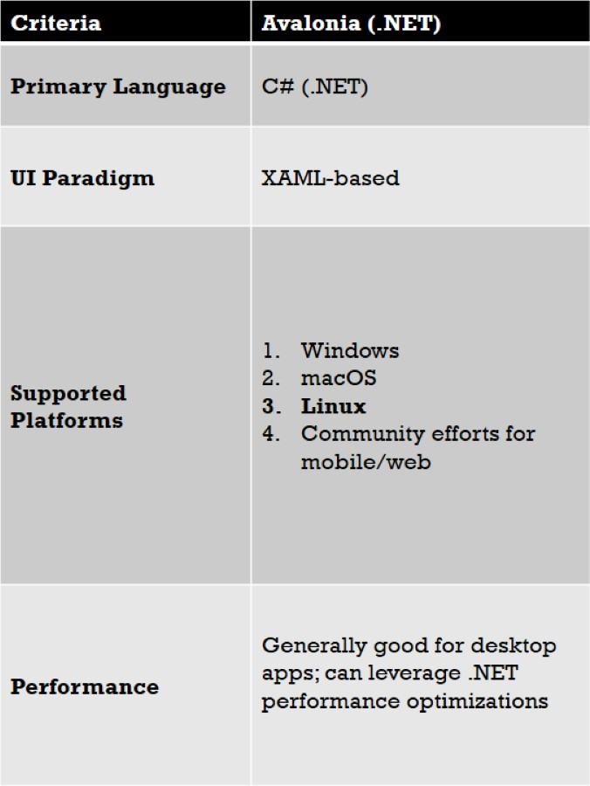
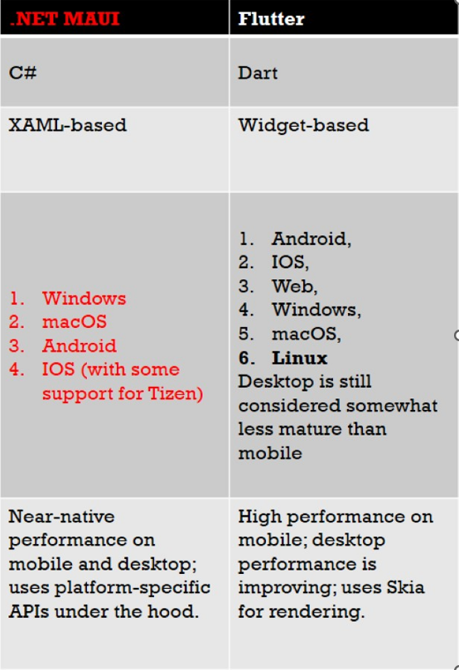

Slide 5
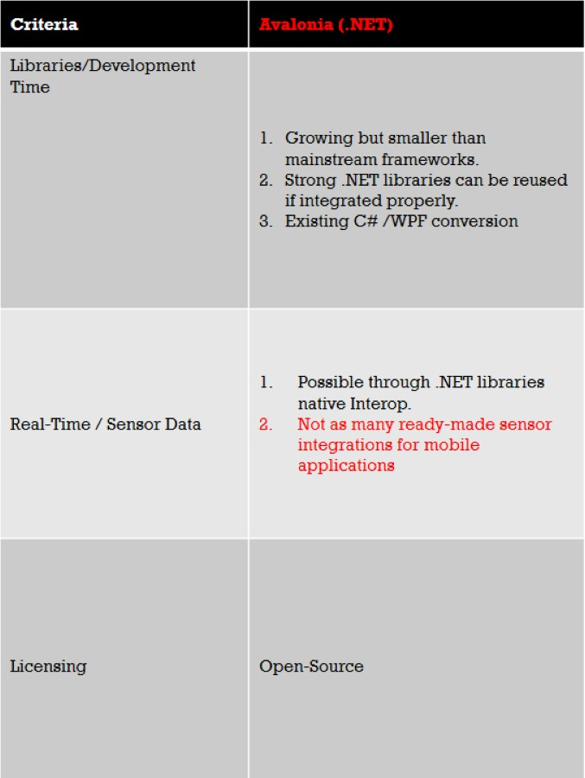
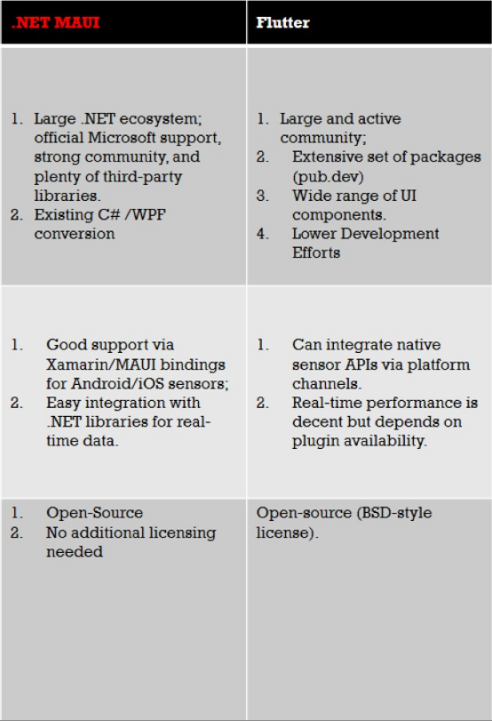

Slide 6
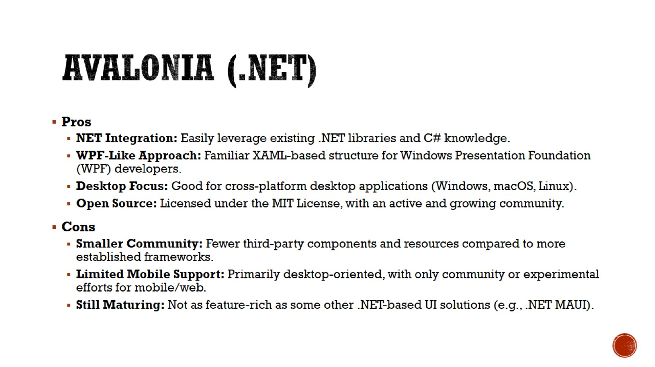
Avalonia (.NET)

Slide 7
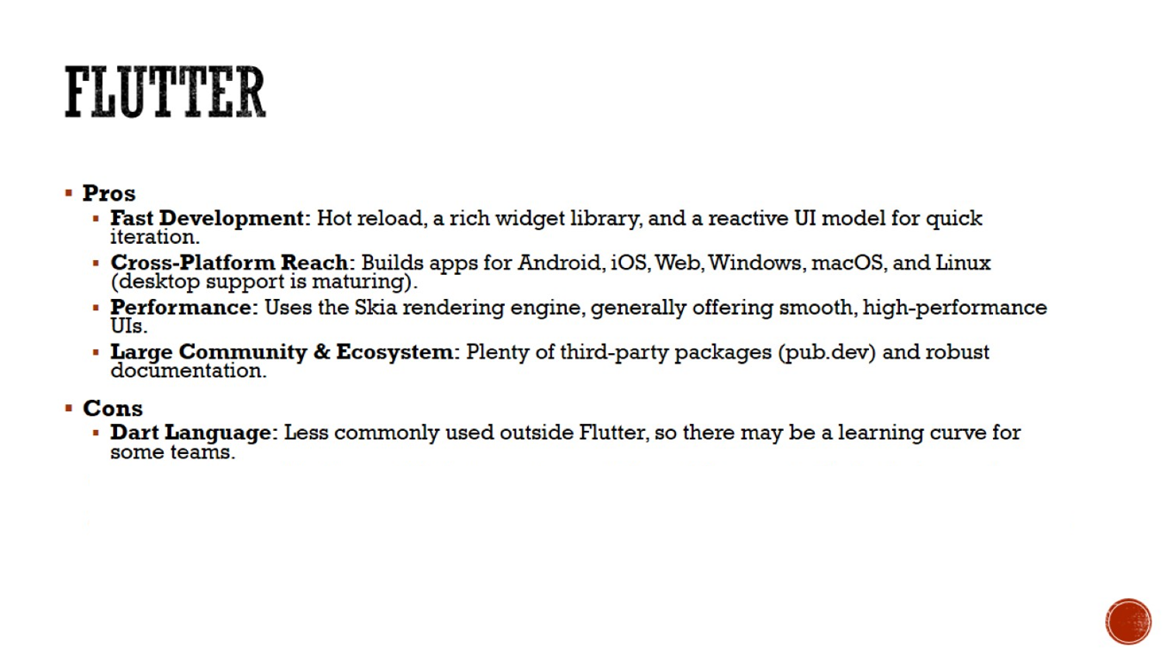
Flutter

Slide 8
Inter Protocol Communication

Slide 9
What is GRPC

Slide 10
What is ZeroMQ

Slide 11
What is NNG

Slide 12
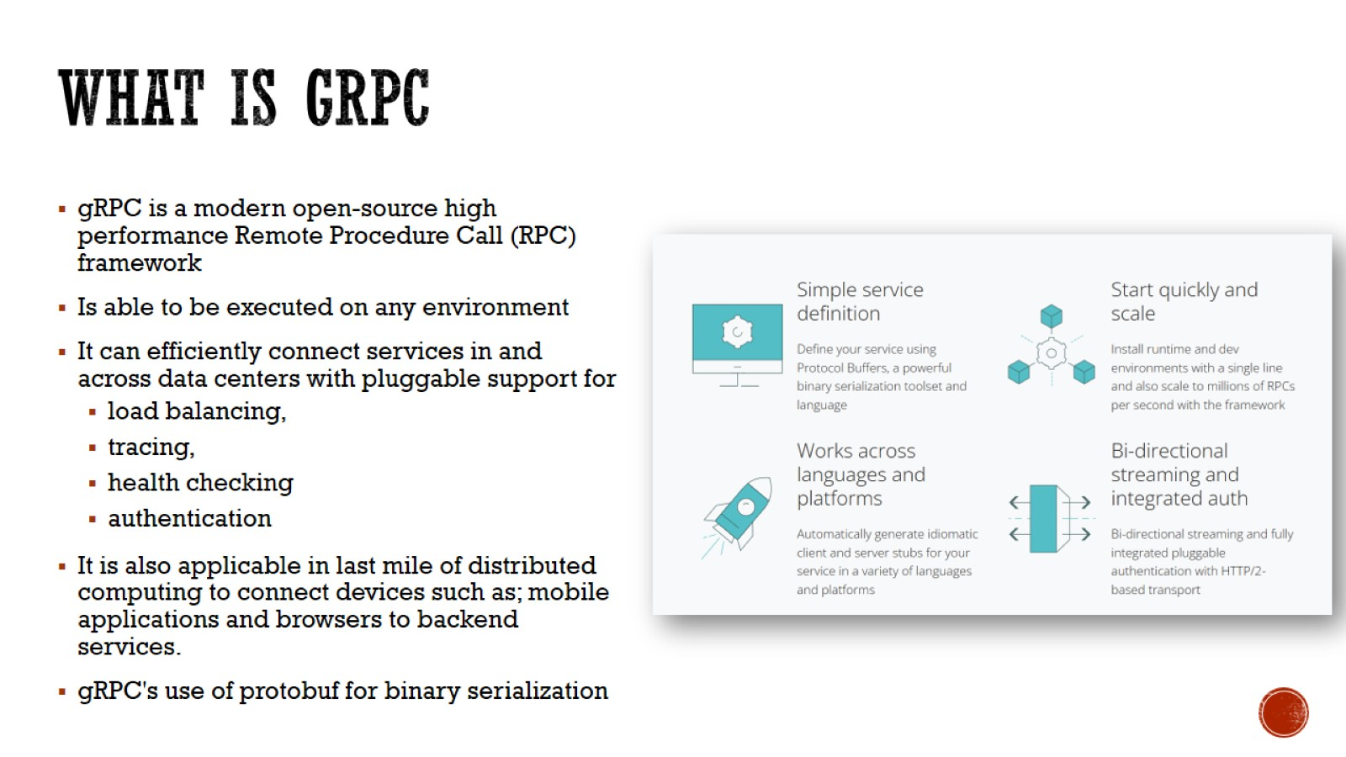
What is gRPC

Slide 13
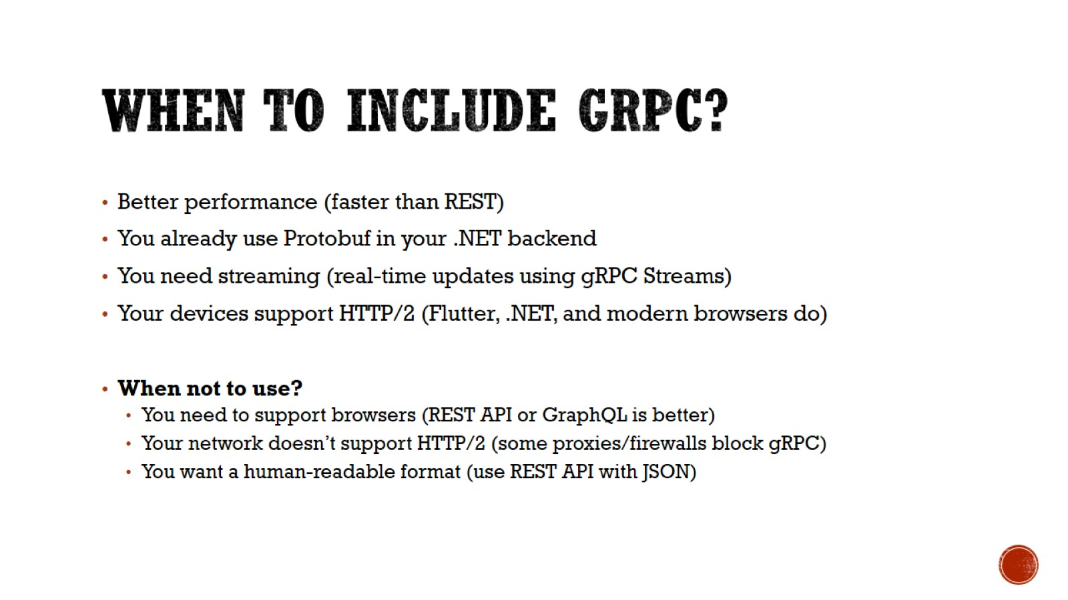
When to Include gRPC?

Slide 14
Proposed Models

Slide 15
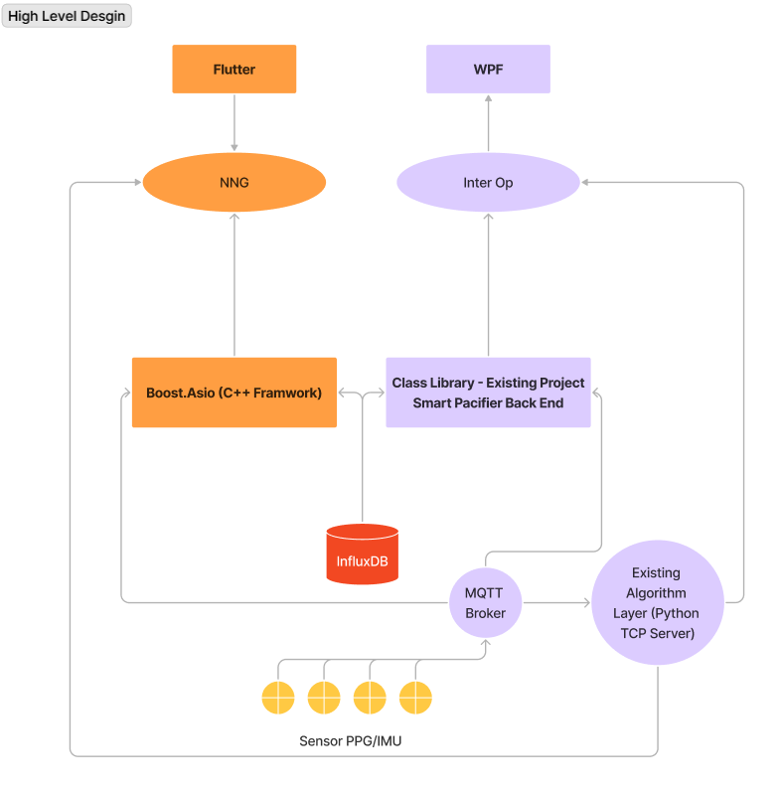
MODEL – 3 {Huge Improvements}
NNG
No Web Overhead
NNG Supports
Linux
MacOS
Windows
Android
iOS
Mature and Supported
Successor of ZeroMQ
Boost.Asio (C++)
High-performance, real-time, asynchronous message handling
Works natively on Windows, Linux, macOS, Android, iOS
Lightweight and No Web Dependencies
Scalable and Modern
Best for real-time sensor data processing

Slide 16
Model 3 - Basic Data Flow
1️⃣ Sensor Device → Sends Protobuf-serialized sensor data 2️⃣ MQTT- Broker → Receives & forwards the serialized Protobuf data 3️⃣ C++ Backend (Boost.Asio + NNG) → Receives MQTT messages, but instead of sending each message immediately, it:
Buffers multiple messages together into a batch.
Sends the batch via NNG at fixed intervals (e.g., every 50ms).
4️⃣ Flutter UI (FFI + NNG) → Receives batched Protobuf data, deserializes, and updates the UI.
Instead of rendering every new message immediately, Flutter:
Processes messages in a background isolate.
Uses a stream buffer to update the UI at a controlled rate.
Foreign Function Interface
Wraps Incoming data for Android, iOS, Windows, Linux
Direct native communication with C++
High performance
Drawback → Requires writing some FFI bindings

Slide 17
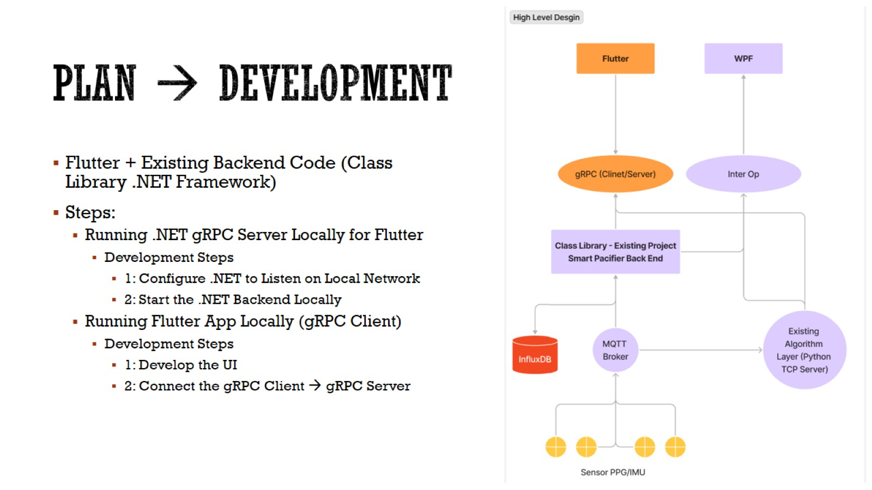
Plan → Development

Slide 18
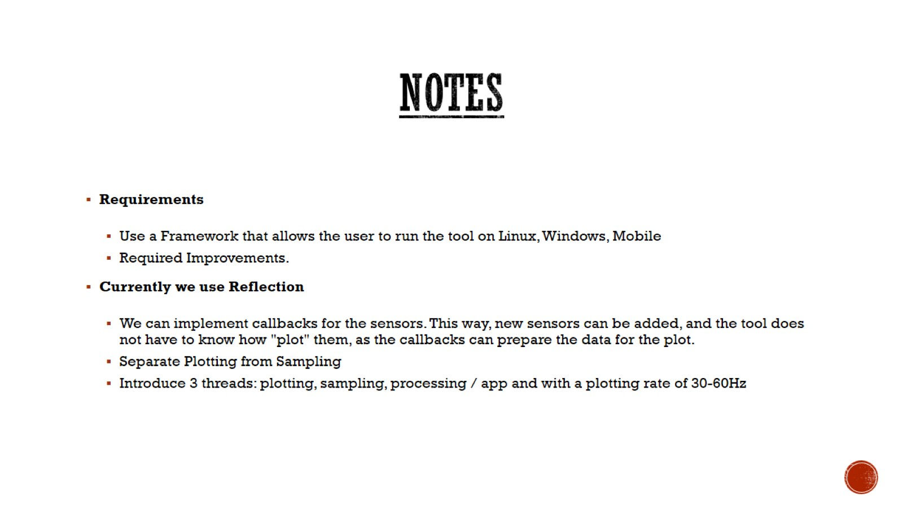
Notes

Slide 19
Open Questions
Will you be connecting the sensors with the mobile also

